Slide 1

Tugas Besar Pemrograman Berorientasi Objek
There is 1 error syntax among us
Error

Slide 2
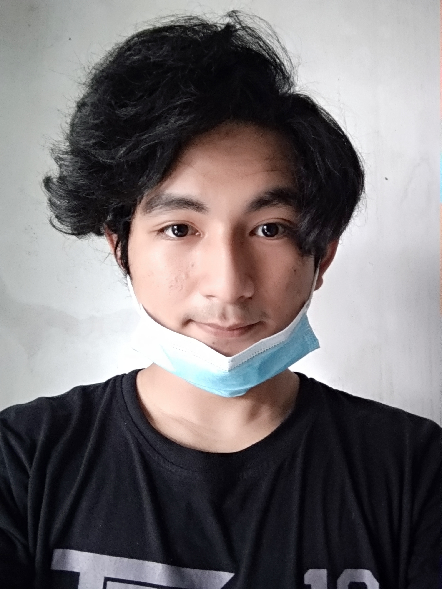

Perkenalan!
Nama : Muh. Baharuddin
NPM : 4519210022
Hobby : Rebahan Santuy

Slide 3

Kriteria Tugas Besar
01
02
Menu Pilihan berulang
Method Setter Getter
03
04
Minimal 5 Method
Objek Minimal 2
Running Program

Slide 4

Menu Pilihan Berulang
User Melakukan pengecekan kouta internet
User berhenti/selesai melakukan pengisian
User Melakukan pengecekan pulsa
1. Cek Pulsa
3. Cek Kouta
5. Berhenti
Back
2. Isi Pulsa
4. Isi Kouta
More
User Melakukan pengisian pulsa
User Melakukan pengisian kouta internet

Slide 5
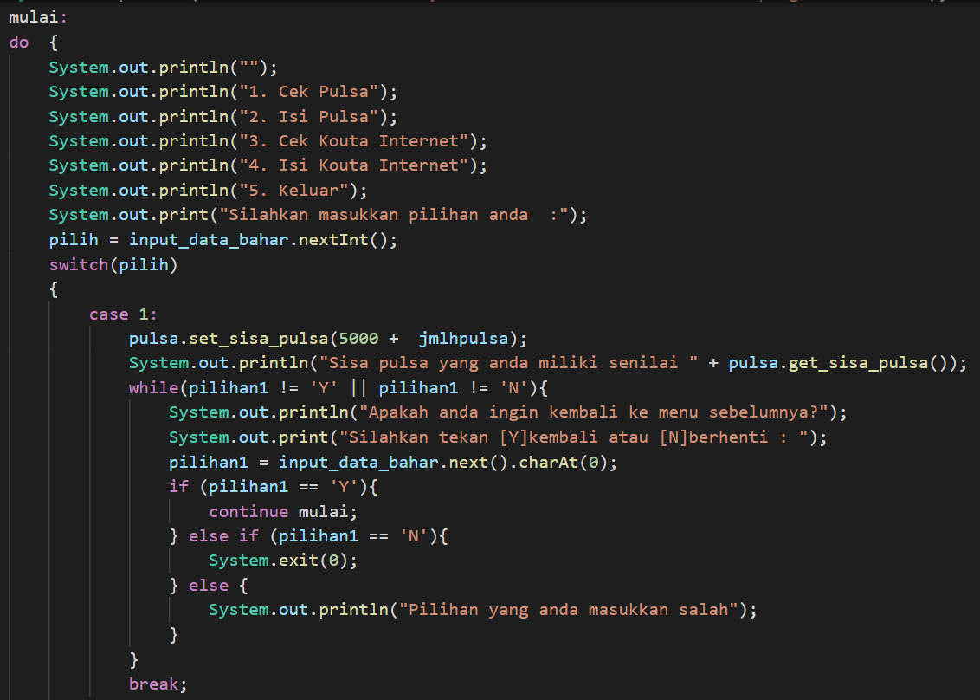
Program Menu Pilihan
Back
More

Slide 6
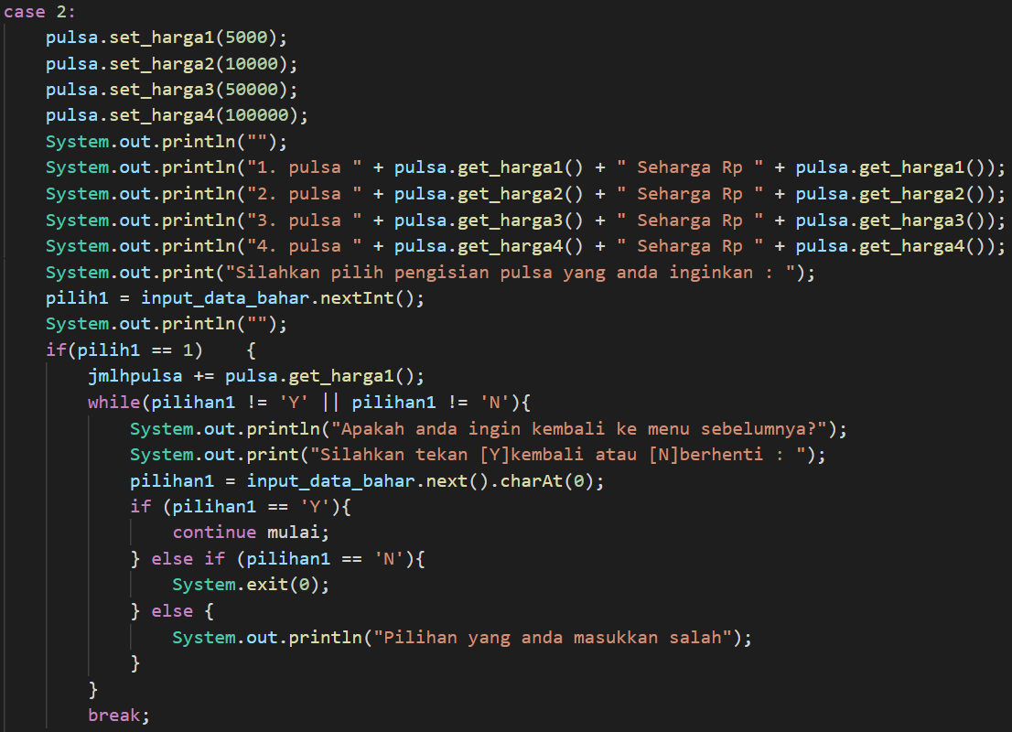
Program Menu Pilihan
Back
More

Slide 7
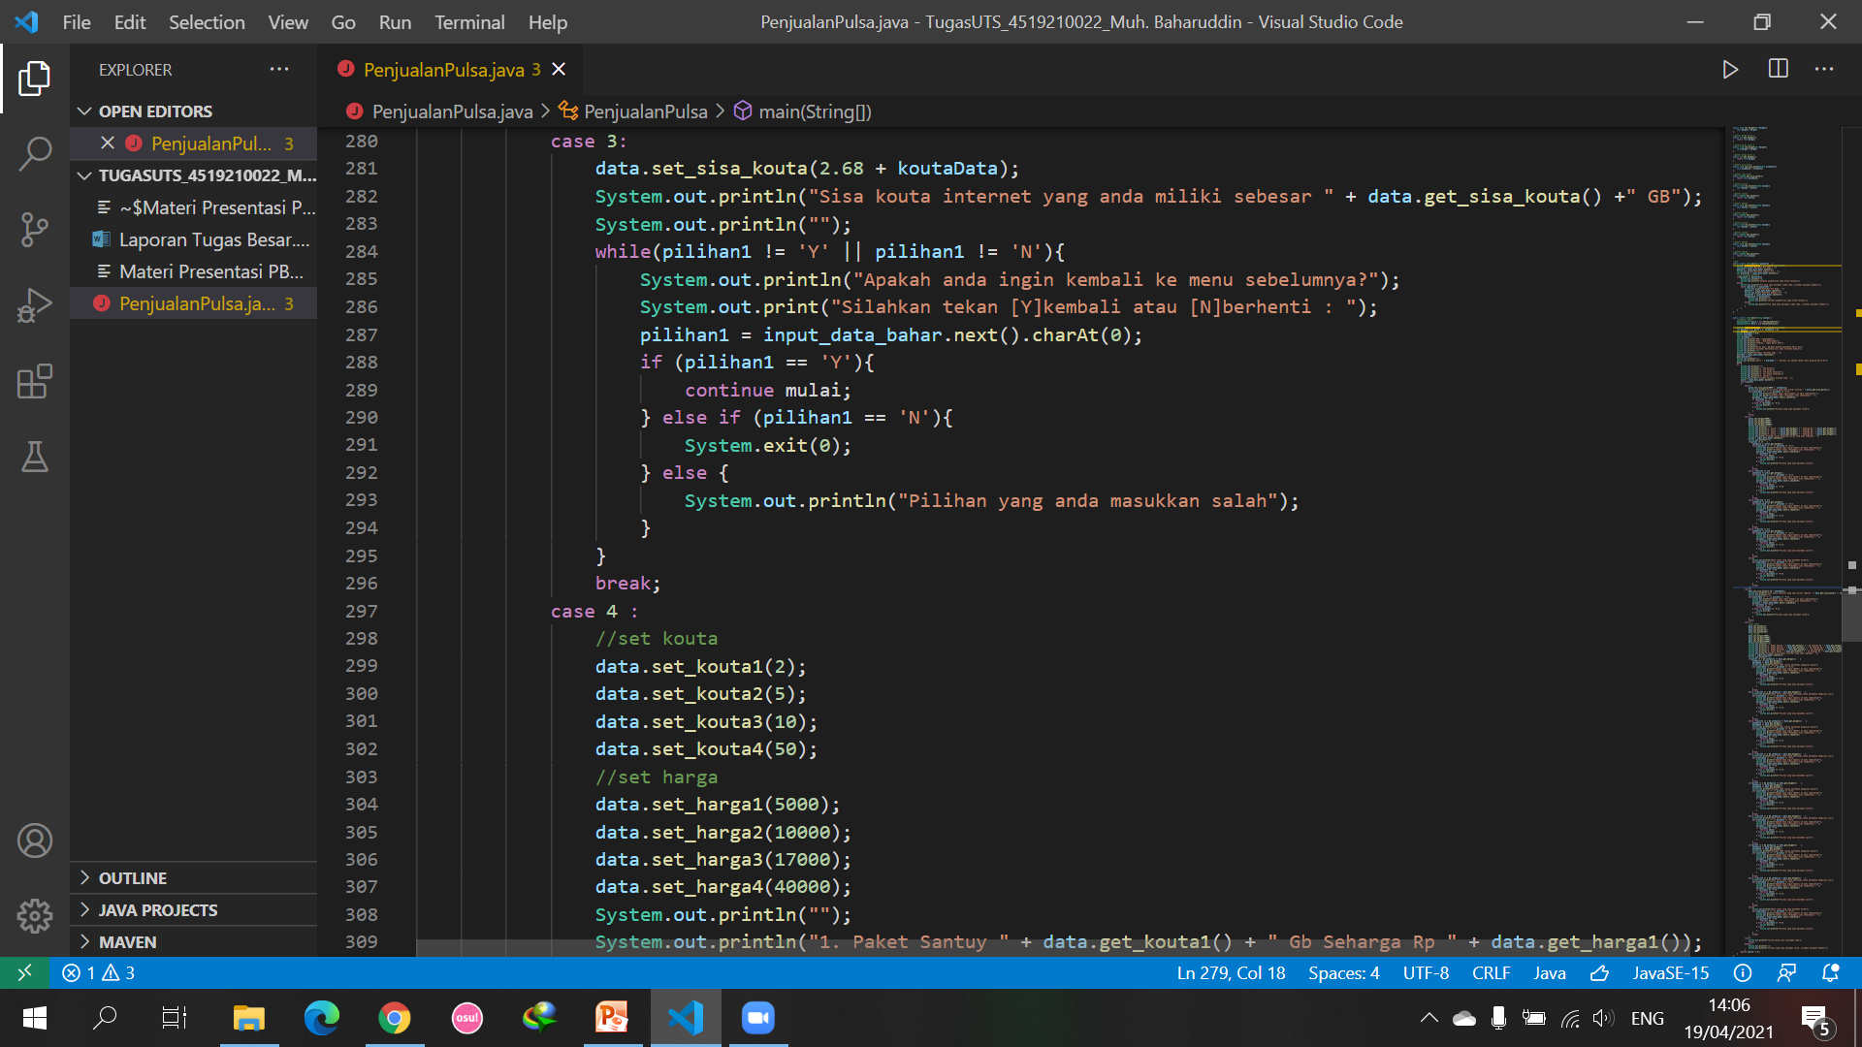
Program Menu Pilihan
Back
More

Slide 8
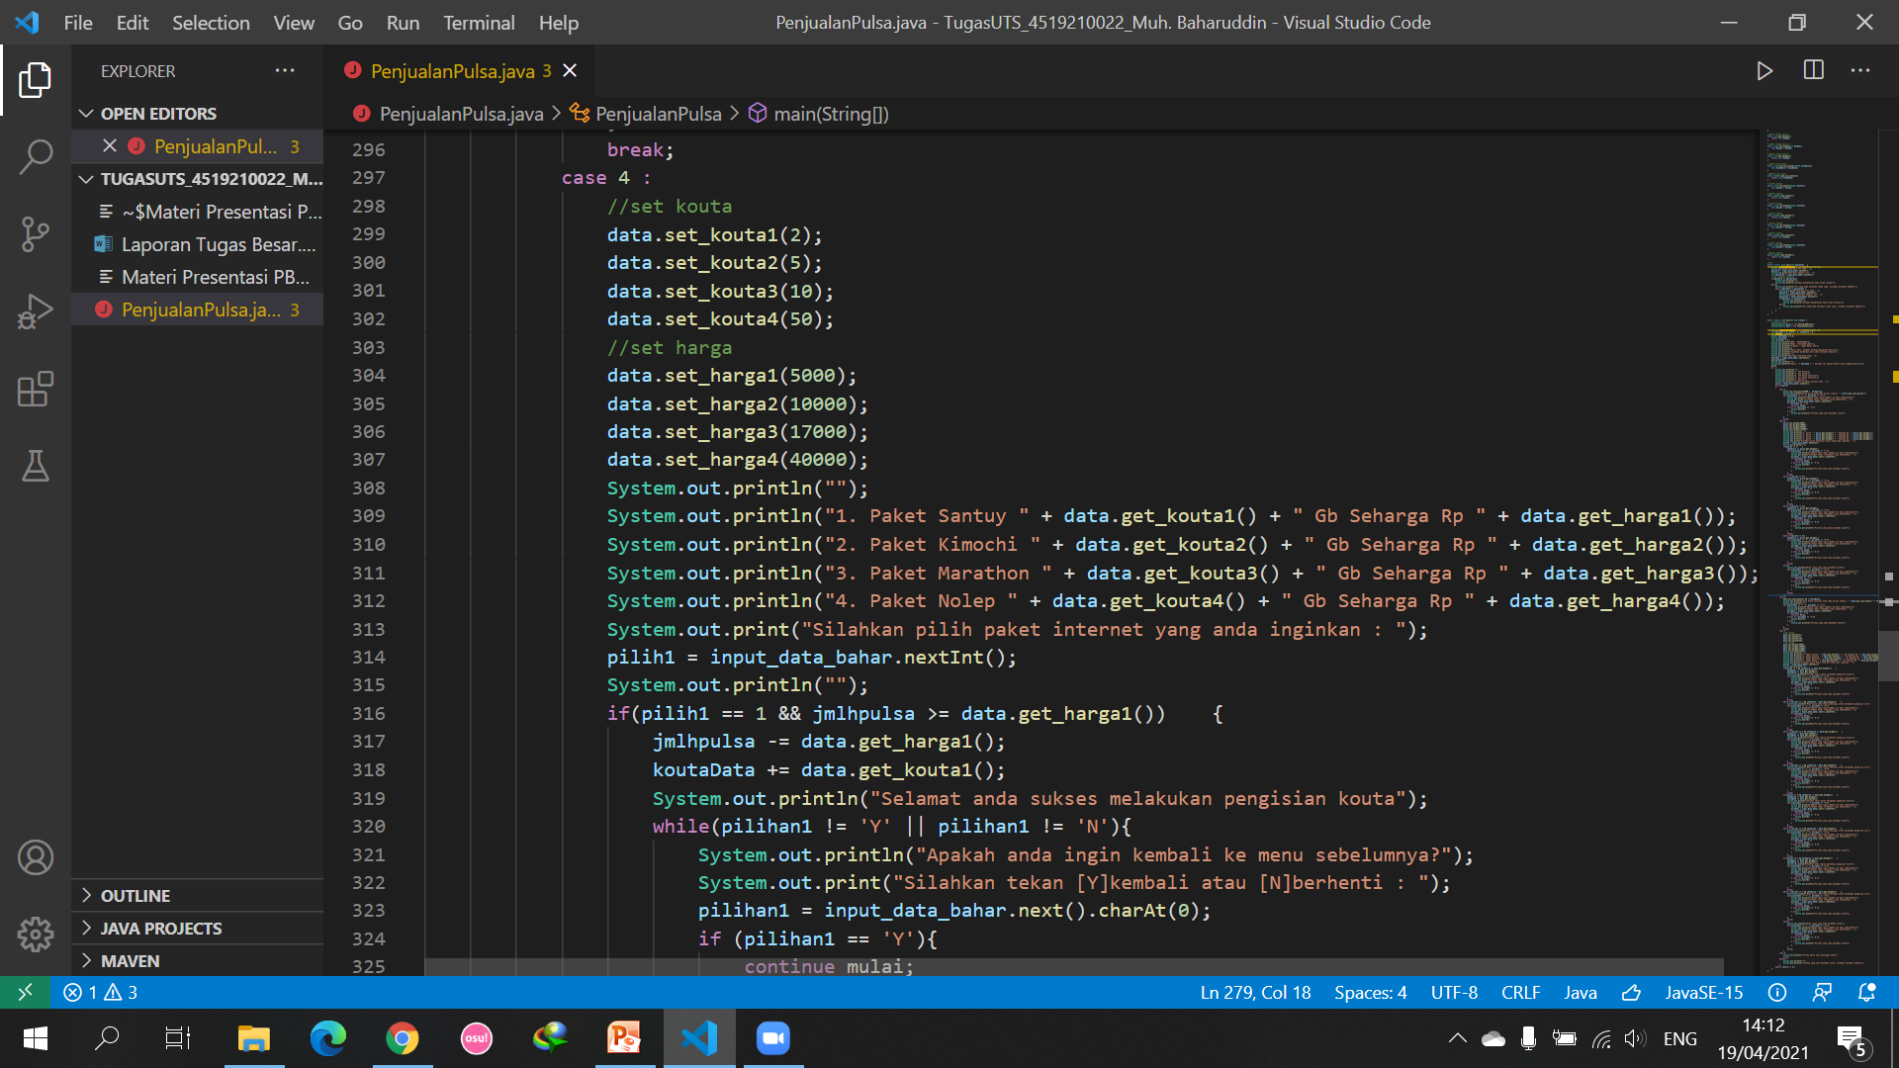
Program Menu Pilihan
Back
More

Slide 9
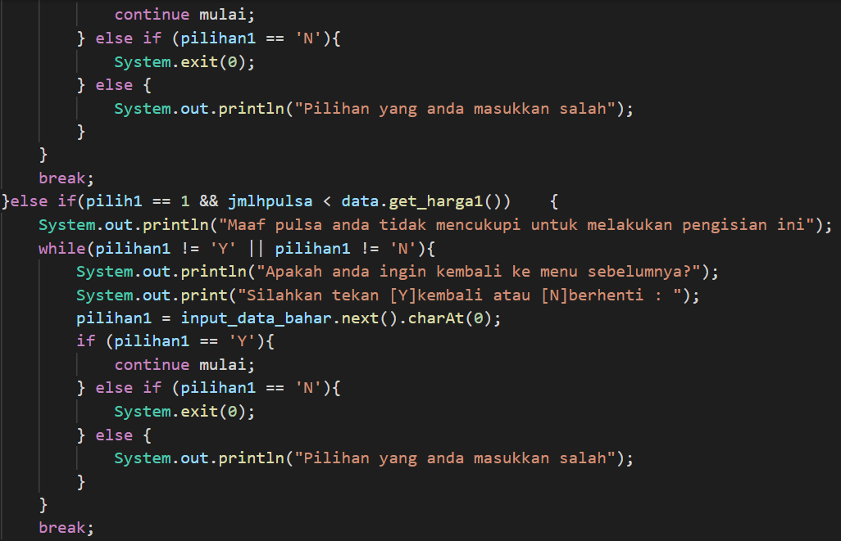
Program Menu Pilihan
Back
Home

Slide 10
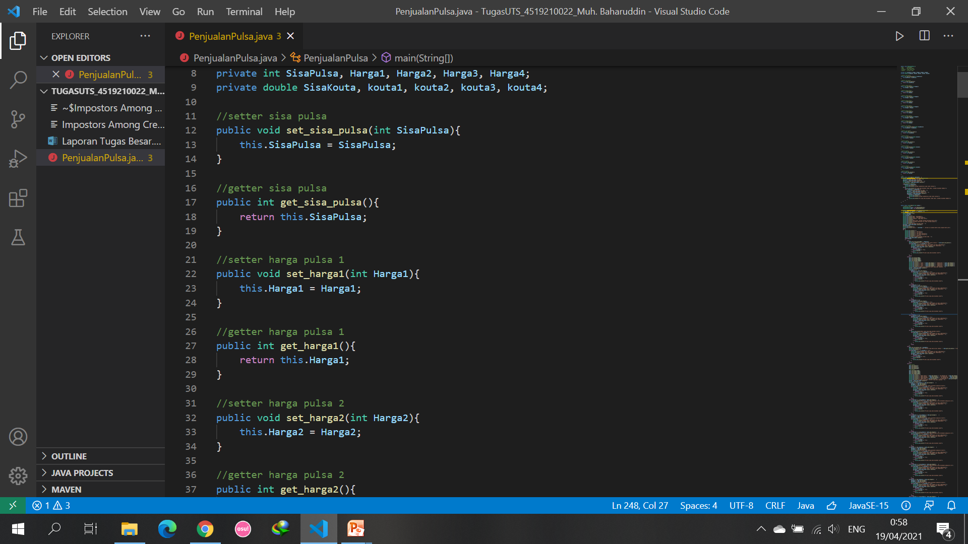
Program Setter Getter
Back

Slide 11
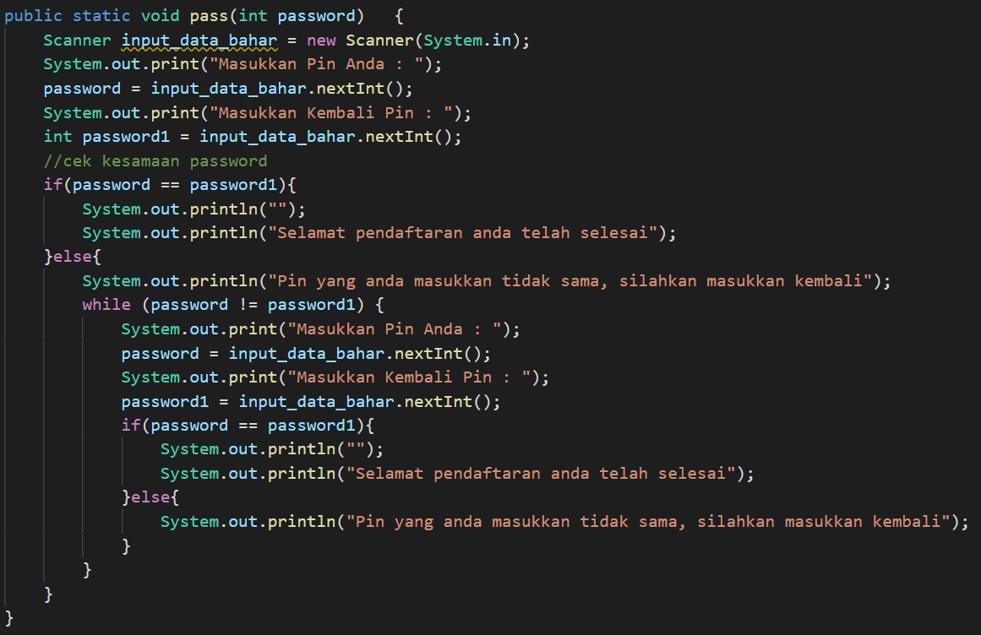
Method
Back

Slide 12
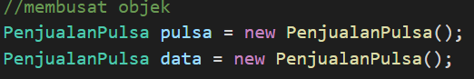
Objek
Back

Slide 13
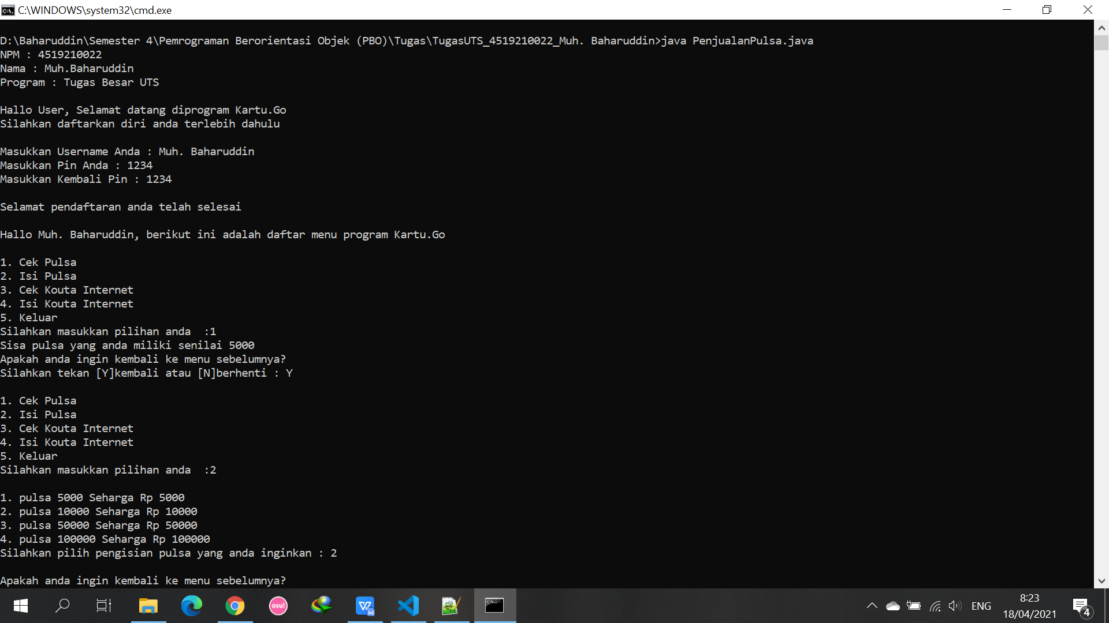


Running Program
Back
More

Slide 14
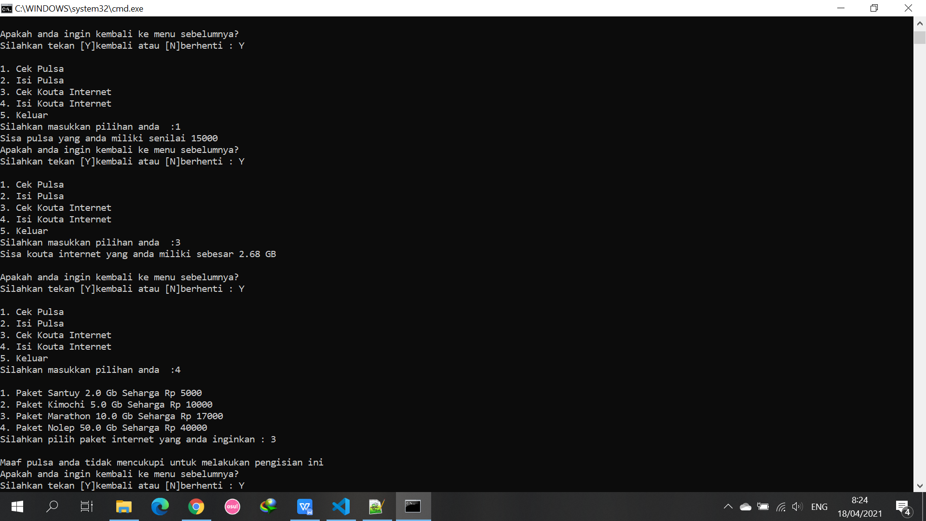
Running Program
Back
More

Slide 15
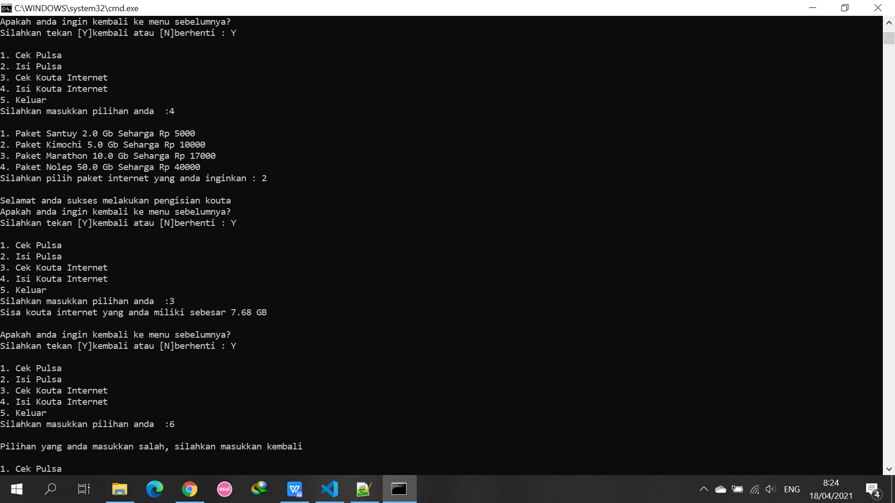
Running Program
Back
More

Slide 16
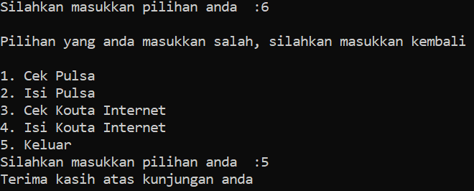

Running Program
Back

Slide 17

Terima Kasih!
Contact :
muhbaharuddin67@gmail.com
+62 823 4786 9341
Error

